Slide 1


SIDDHESH GORE
16-NOV-23

Slide 2
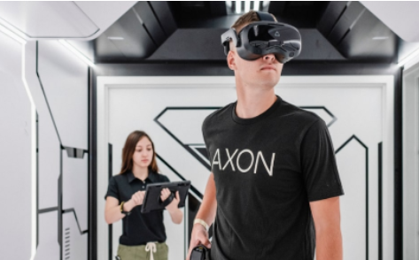
AGENDA
Company Overview
Economy
Industry
Company Analysis

Slide 3
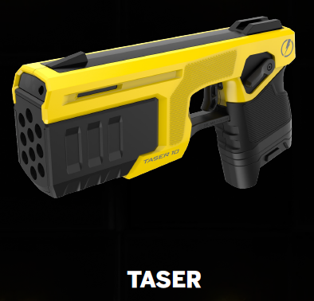
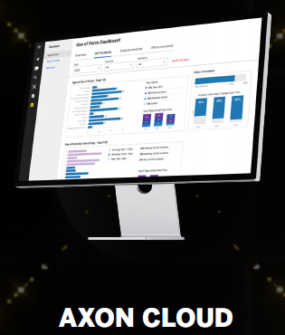
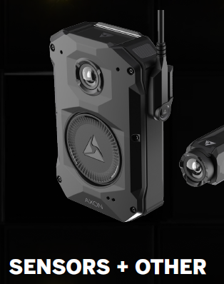
ABOUT
Executive Summary:
Axon Enterprise is a leading public safety technology company that delivers a comprehensive suite of interconnected devices, software, and data analytics solutions to law enforcement agencies, militaries, and civilians worldwide. The company is dedicated to safeguarding life by providing cutting-edge solutions that enhance safety, transparency, and accountability.
Headquarters:
Scottsdale, AZ
US

Slide 4
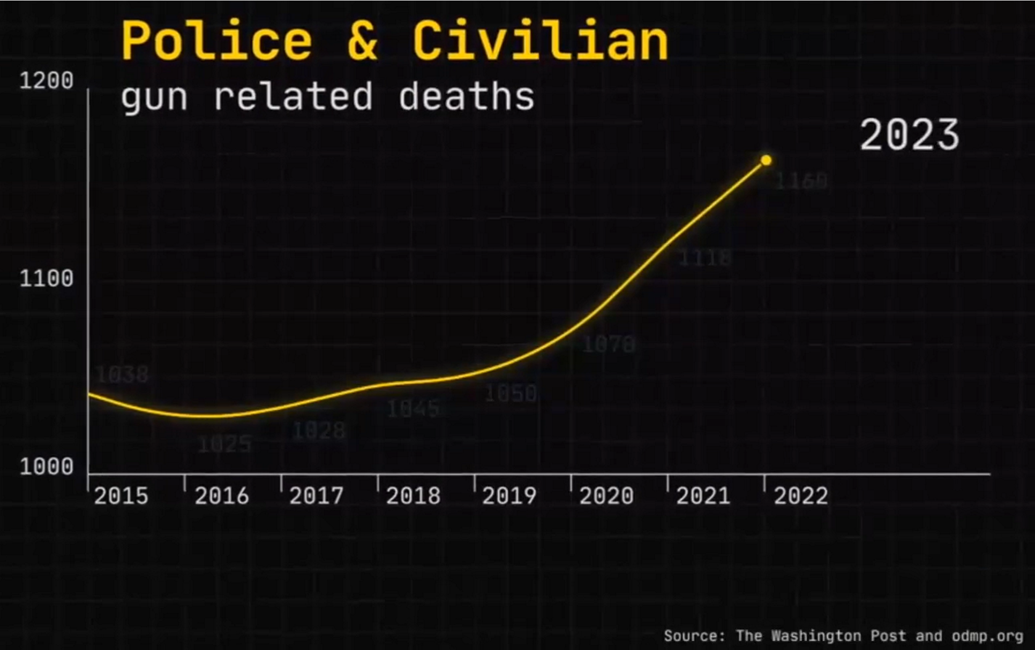
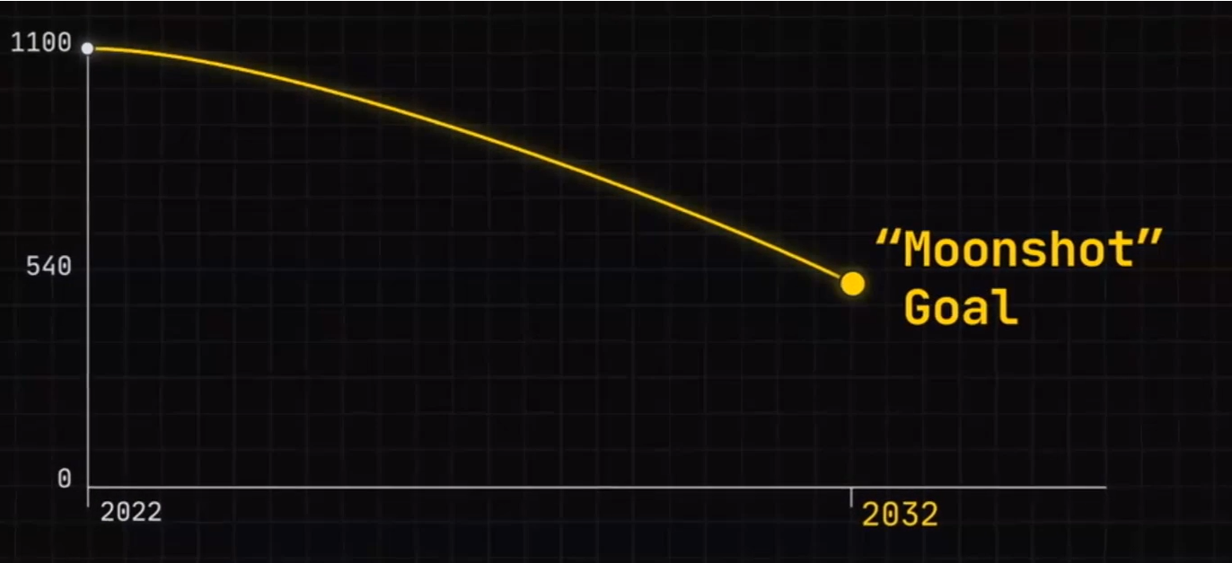
MISSION : MOONSHOT GOAL
Aim: Reduce gun related death by 50% in 10 years

Slide 5
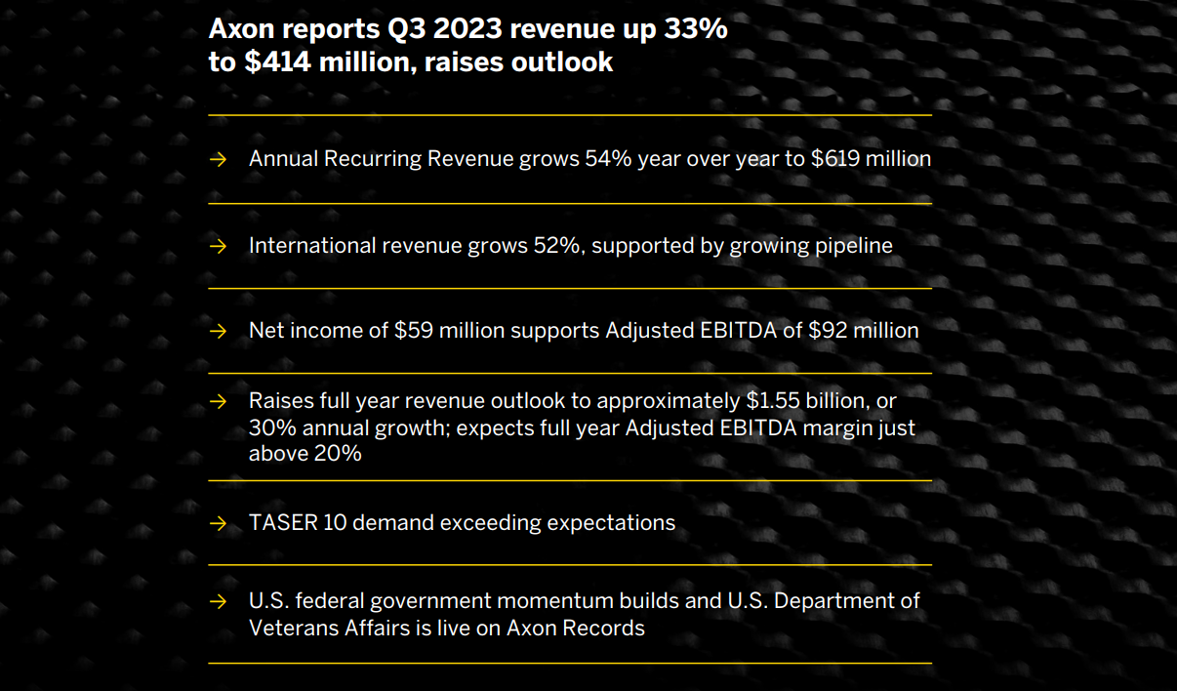
AXON’S PERFORMANCE AT A GLANCE

Slide 6

RECOMMENDATION
CURRENT
PRICE
MARKET
CAP
MODEL PRICE
$216.00 BASE
$222.00
16.692B
$245.19 BEST

Slide 7
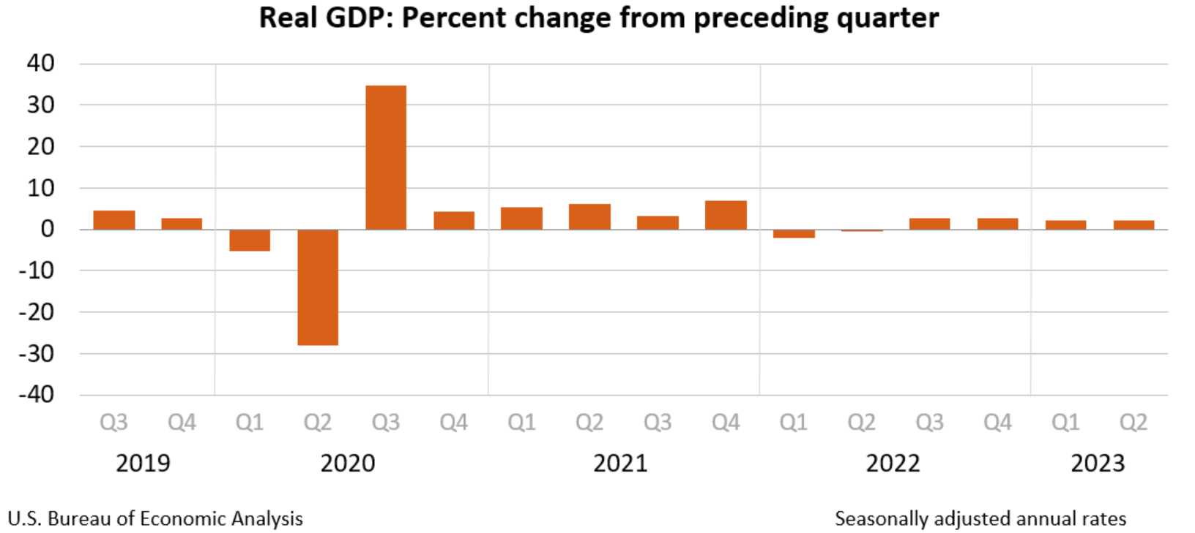
US ECONOMY OVERVIEW

Slide 8
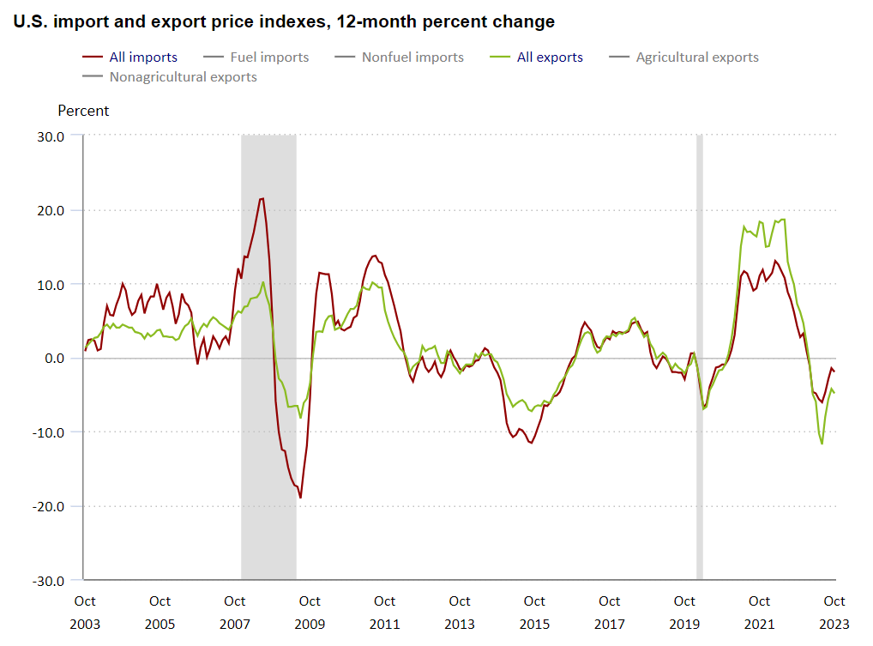
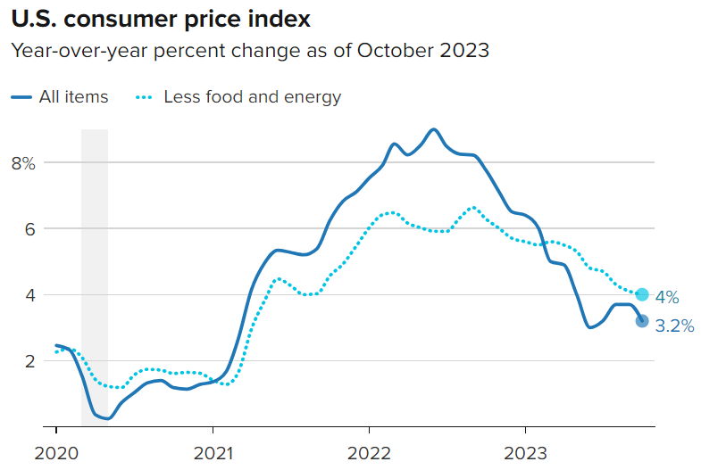
US ECONOMY OVERVIEW

Slide 9
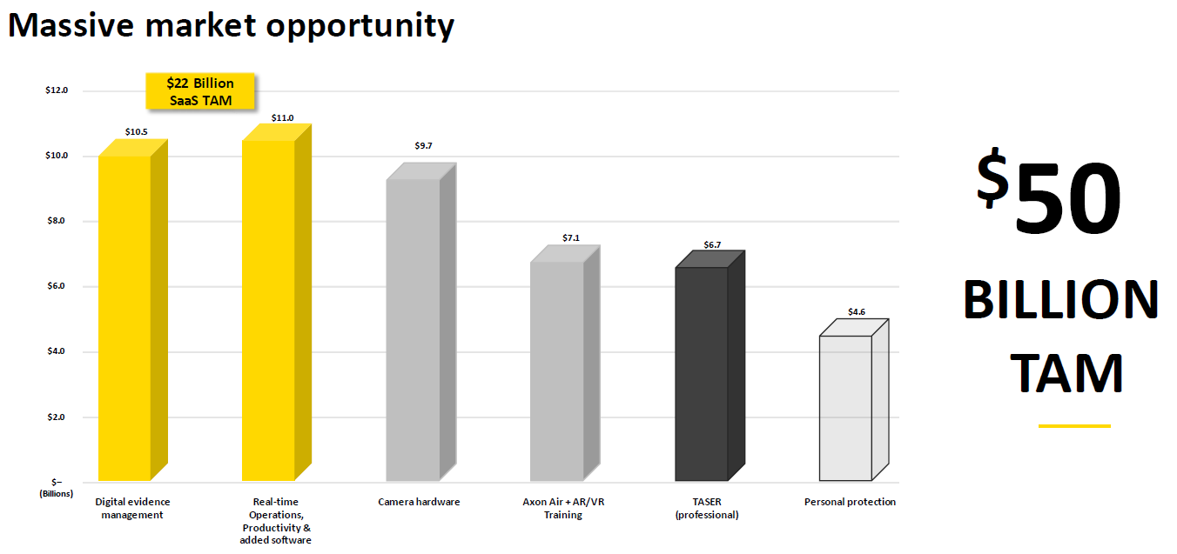
INDUSTRY ANALYSIS

Slide 10
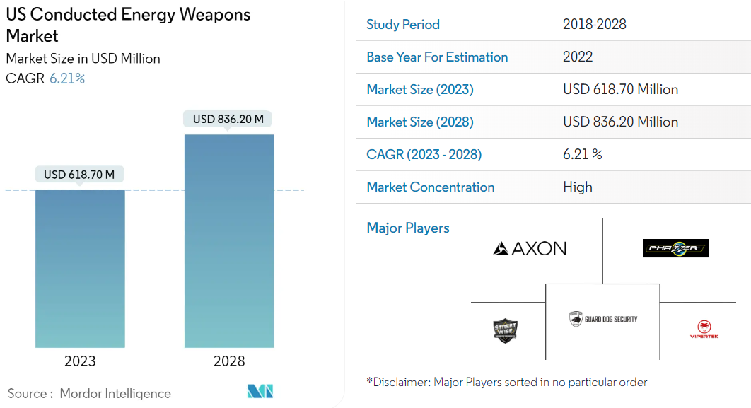
INDUSTRY ANALYSIS
Notes:
CEWs deliver an electrical current that interferes with the body's neuromuscular system, temporarily disrupting voluntary muscle control. This effect can render a suspect temporarily immobilized and make it easier for officers to gain control of the situation. It is intended to be temporary and wears off once the electrical current ceases. Source: https://www.mordorintelligence.com/industry-reports/us-conducted-energy-weapons-market

Slide 11
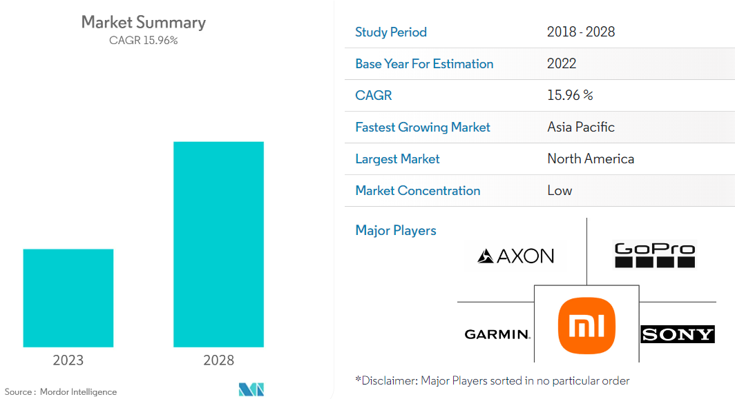
INDUSTRY ANALYSIS
Body Worn Camera
Market Size
Notes:
CEWs deliver an electrical current that interferes with the body's neuromuscular system, temporarily disrupting voluntary muscle control. This effect can render a suspect temporarily immobilized and make it easier for officers to gain control of the situation. It is intended to be temporary and wears off once the electrical current ceases. Source: https://www.mordorintelligence.com/industry-reports/us-conducted-energy-weapons-market

Slide 12
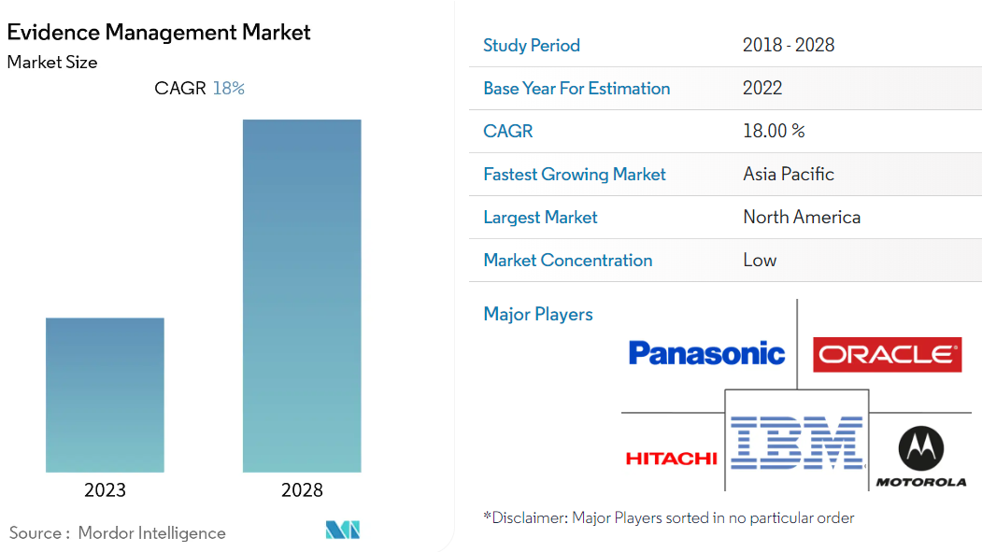
INDUSTRY ANALYSIS
Notes:
CEWs deliver an electrical current that interferes with the body's neuromuscular system, temporarily disrupting voluntary muscle control. This effect can render a suspect temporarily immobilized and make it easier for officers to gain control of the situation. It is intended to be temporary and wears off once the electrical current ceases. Source: https://www.mordorintelligence.com/industry-reports/us-conducted-energy-weapons-market

Slide 13
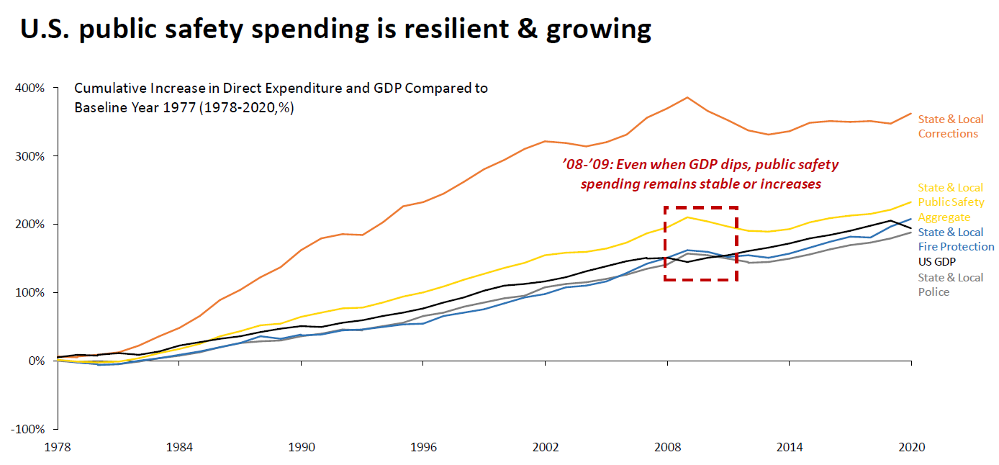
INDUSTRY ANALYSIS
Notes:
CEWs deliver an electrical current that interferes with the body's neuromuscular system, temporarily disrupting voluntary muscle control. This effect can render a suspect temporarily immobilized and make it easier for officers to gain control of the situation. It is intended to be temporary and wears off once the electrical current ceases. Source: https://www.mordorintelligence.com/industry-reports/us-conducted-energy-weapons-market

Slide 14

BOARD OF DIRECTORS
Notes:
CEWs deliver an electrical current that interferes with the body's neuromuscular system, temporarily disrupting voluntary muscle control. This effect can render a suspect temporarily immobilized and make it easier for officers to gain control of the situation. It is intended to be temporary and wears off once the electrical current ceases. Source: https://www.mordorintelligence.com/industry-reports/us-conducted-energy-weapons-market

Slide 15
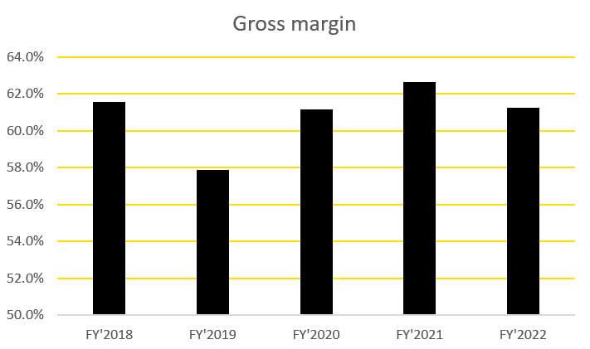
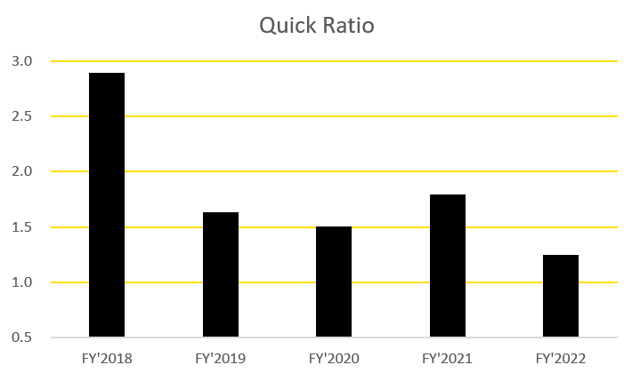
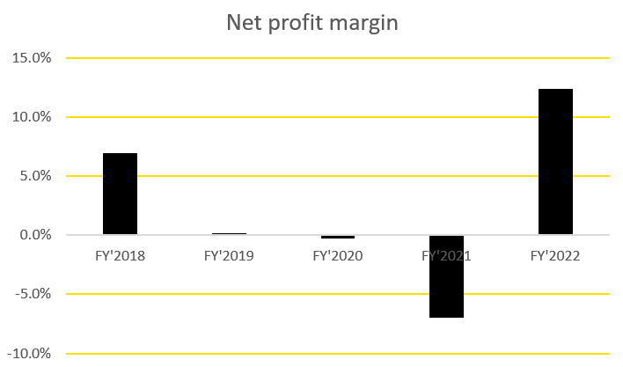
AXON KEY RATIOS (HISTORIC)
Notes:
CEWs deliver an electrical current that interferes with the body's neuromuscular system, temporarily disrupting voluntary muscle control. This effect can render a suspect temporarily immobilized and make it easier for officers to gain control of the situation. It is intended to be temporary and wears off once the electrical current ceases. Source: https://www.mordorintelligence.com/industry-reports/us-conducted-energy-weapons-market

Slide 16
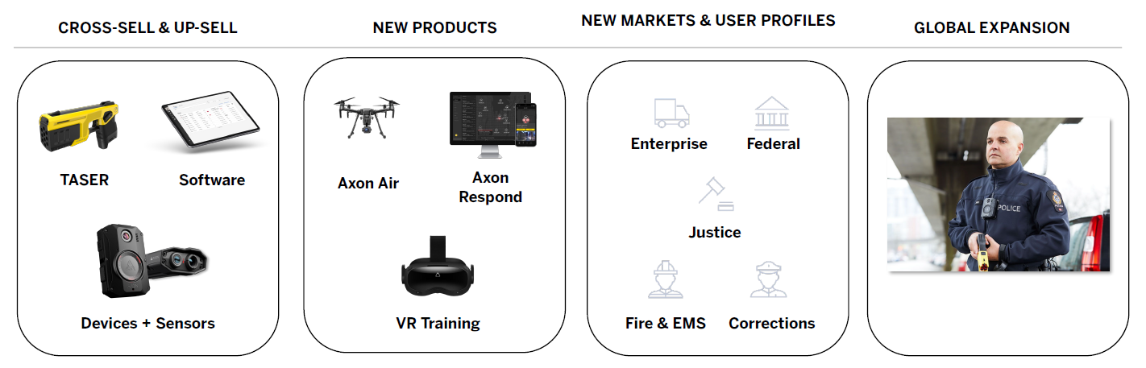
AXON PRODUCTS
Notes:
CEWs deliver an electrical current that interferes with the body's neuromuscular system, temporarily disrupting voluntary muscle control. This effect can render a suspect temporarily immobilized and make it easier for officers to gain control of the situation. It is intended to be temporary and wears off once the electrical current ceases. Source: https://www.mordorintelligence.com/industry-reports/us-conducted-energy-weapons-market

Slide 17
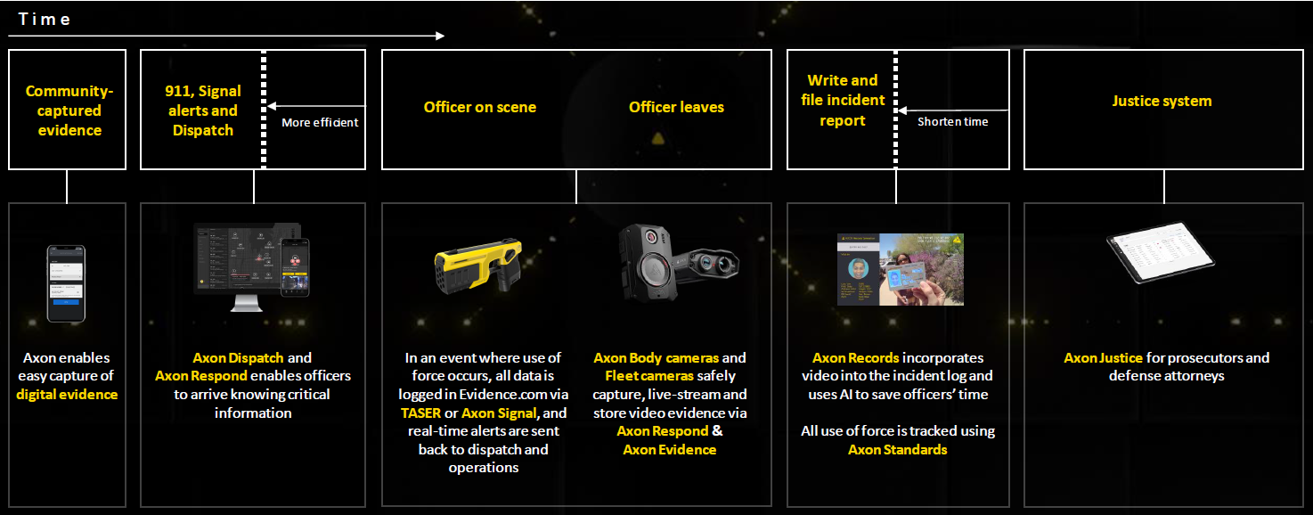
AXON’S VISION (THE BIG PICTURE)
Notes:
CEWs deliver an electrical current that interferes with the body's neuromuscular system, temporarily disrupting voluntary muscle control. This effect can render a suspect temporarily immobilized and make it easier for officers to gain control of the situation. It is intended to be temporary and wears off once the electrical current ceases. Source: https://www.mordorintelligence.com/industry-reports/us-conducted-energy-weapons-market

Slide 18
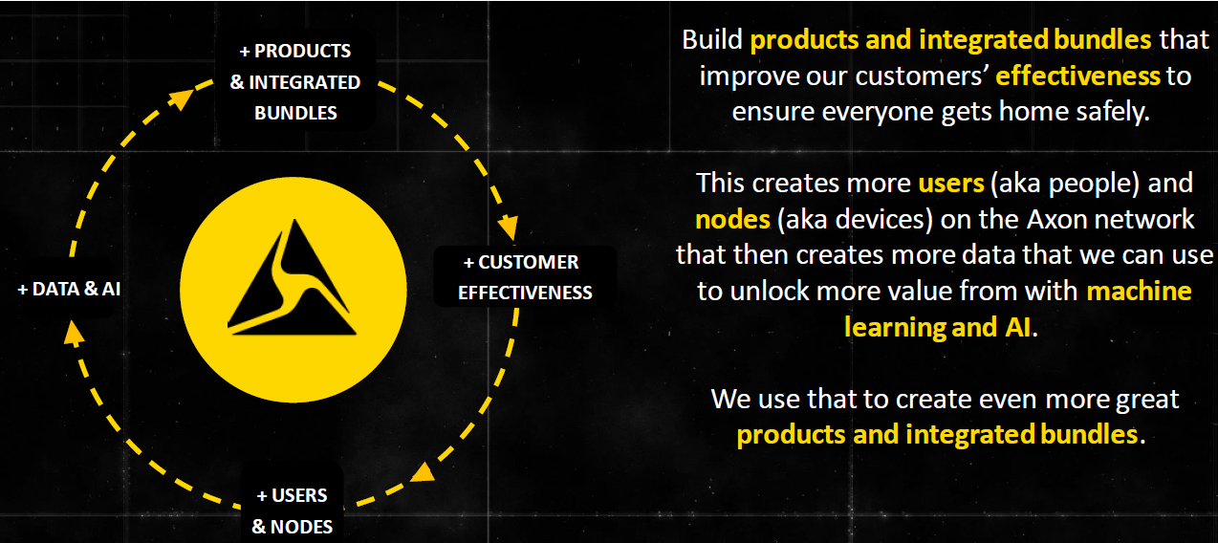
FLYWHEEL EFFECT
Notes:
CEWs deliver an electrical current that interferes with the body's neuromuscular system, temporarily disrupting voluntary muscle control. This effect can render a suspect temporarily immobilized and make it easier for officers to gain control of the situation. It is intended to be temporary and wears off once the electrical current ceases. Source: https://www.mordorintelligence.com/industry-reports/us-conducted-energy-weapons-market

Slide 19

MARKET PENETRATION DRIVERS (TO WHOM THEY SELL)
Notes:
CEWs deliver an electrical current that interferes with the body's neuromuscular system, temporarily disrupting voluntary muscle control. This effect can render a suspect temporarily immobilized and make it easier for officers to gain control of the situation. It is intended to be temporary and wears off once the electrical current ceases. Source: https://www.mordorintelligence.com/industry-reports/us-conducted-energy-weapons-market

Slide 20
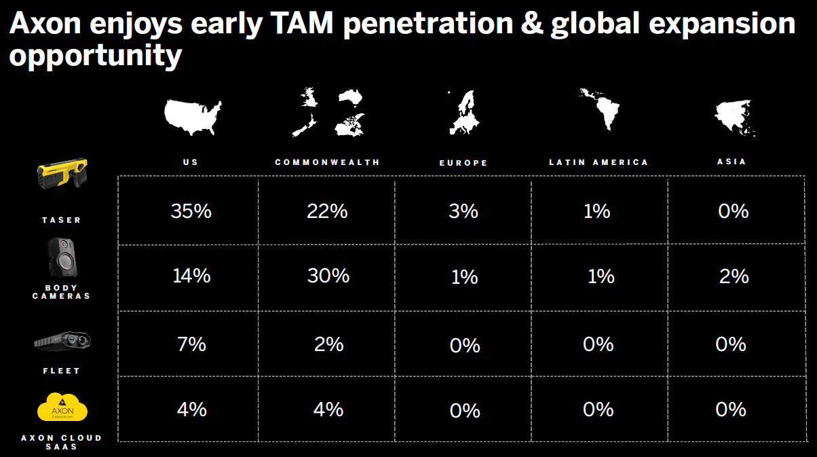
GROWTH OPPORTUNITIES
Notes:
CEWs deliver an electrical current that interferes with the body's neuromuscular system, temporarily disrupting voluntary muscle control. This effect can render a suspect temporarily immobilized and make it easier for officers to gain control of the situation. It is intended to be temporary and wears off once the electrical current ceases. Source: https://www.mordorintelligence.com/industry-reports/us-conducted-energy-weapons-market

Slide 21
GROWTH OPPORTUNITIES
TASER:
User adoption of TASER devices is still early outside of US state, local law enforcement, and US federal penetration remains early.
BODY CAMERA:
Body camera user adoption has been steadily growing since 2015 and is still several years away from market saturation.
FLEET:
Fleet in-car cameras enjoy wide growth runway. TAM assumes ~800K vehicles in scope for the US and ~650K internationally.
AXON CLOUD SaaS:
Axon Cloud SaaS software dollar penetration still in its early stages. Axon’s licensed users exhibit healthy revenue retention.
Notes:
CEWs deliver an electrical current that interferes with the body's neuromuscular system, temporarily disrupting voluntary muscle control. This effect can render a suspect temporarily immobilized and make it easier for officers to gain control of the situation. It is intended to be temporary and wears off once the electrical current ceases. Source: https://www.mordorintelligence.com/industry-reports/us-conducted-energy-weapons-market

Slide 22
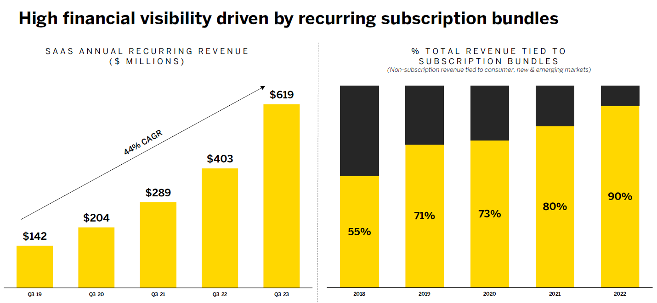
FINANCIAL PERFORMANCE
Notes:
CEWs deliver an electrical current that interferes with the body's neuromuscular system, temporarily disrupting voluntary muscle control. This effect can render a suspect temporarily immobilized and make it easier for officers to gain control of the situation. It is intended to be temporary and wears off once the electrical current ceases. Source: https://www.mordorintelligence.com/industry-reports/us-conducted-energy-weapons-market

Slide 23
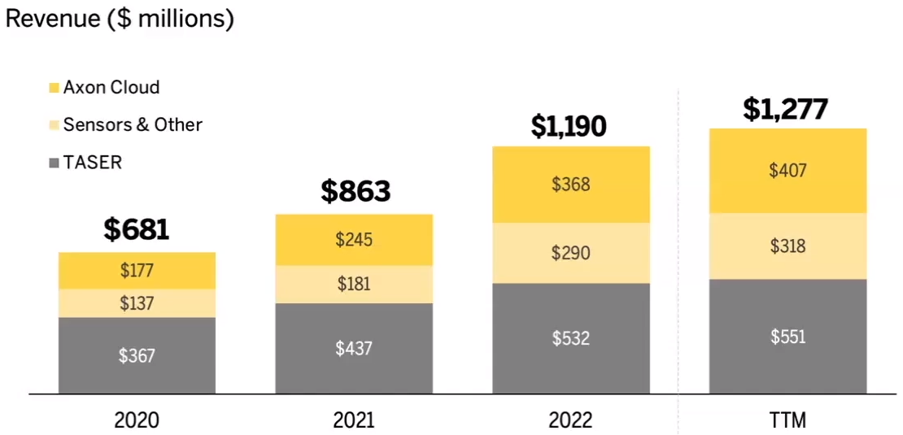
SaaS Growth Is Significant
Notes:
CEWs deliver an electrical current that interferes with the body's neuromuscular system, temporarily disrupting voluntary muscle control. This effect can render a suspect temporarily immobilized and make it easier for officers to gain control of the situation. It is intended to be temporary and wears off once the electrical current ceases. Source: https://www.mordorintelligence.com/industry-reports/us-conducted-energy-weapons-market

Slide 24
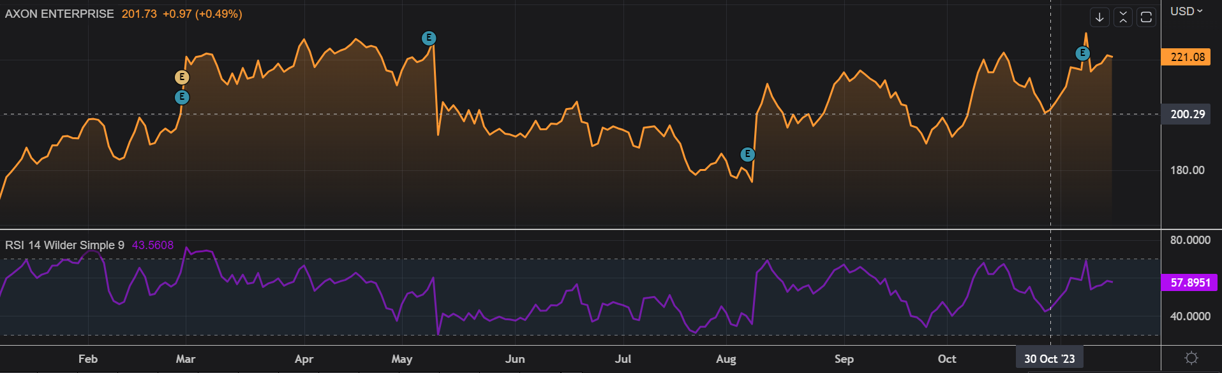
DCF ANALYSIS
Notes:
CEWs deliver an electrical current that interferes with the body's neuromuscular system, temporarily disrupting voluntary muscle control. This effect can render a suspect temporarily immobilized and make it easier for officers to gain control of the situation. It is intended to be temporary and wears off once the electrical current ceases. Source: https://www.mordorintelligence.com/industry-reports/us-conducted-energy-weapons-market

Slide 25
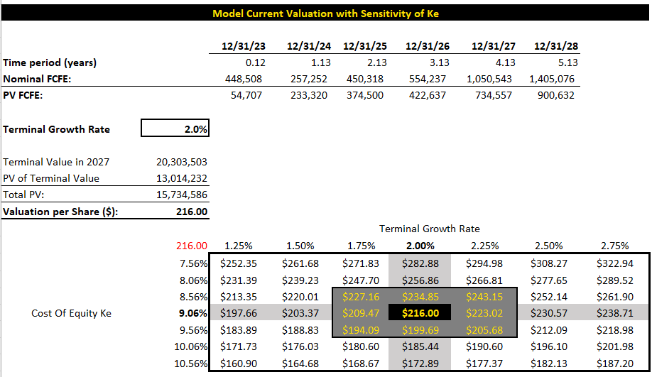
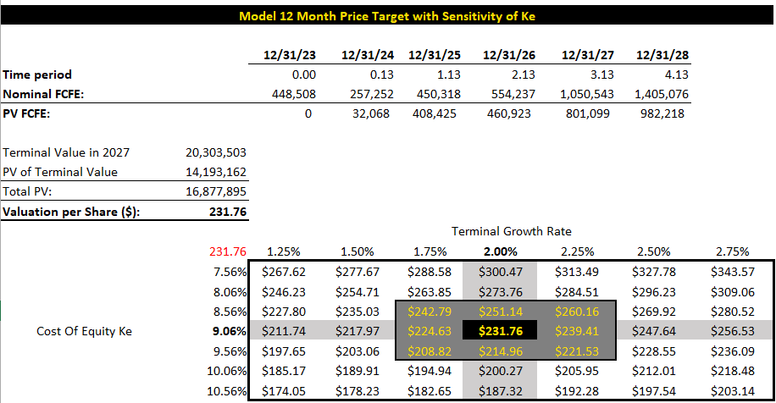
DCF ANALYSIS (BASE CASE)
Current
Next Year
Notes:
CEWs deliver an electrical current that interferes with the body's neuromuscular system, temporarily disrupting voluntary muscle control. This effect can render a suspect temporarily immobilized and make it easier for officers to gain control of the situation. It is intended to be temporary and wears off once the electrical current ceases. Source: https://www.mordorintelligence.com/industry-reports/us-conducted-energy-weapons-market

Slide 26

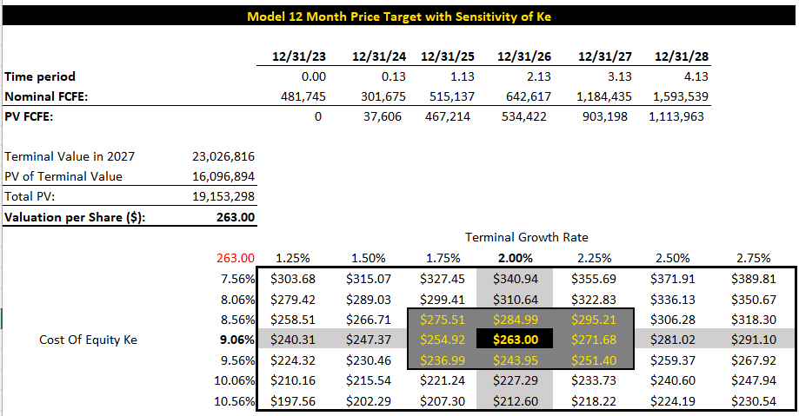
DCF ANALYSIS (BEST CASE)
Current
Next Year
Notes:
CEWs deliver an electrical current that interferes with the body's neuromuscular system, temporarily disrupting voluntary muscle control. This effect can render a suspect temporarily immobilized and make it easier for officers to gain control of the situation. It is intended to be temporary and wears off once the electrical current ceases. Source: https://www.mordorintelligence.com/industry-reports/us-conducted-energy-weapons-market

Slide 27
COMPANY RISKS
SEASONALITY:
Axon has historically experienced higher net sales in our fourth quarter compared to other quarters in the fiscal year due primarily to municipal budget cycles.
STRATEGIC:
substantially depend on sales of our TASER CEDs, and if these products do not continue to be widely accepted, our growth prospects will be diminished.
OPERATIONAL:
Because of the unique requirements of the TASER 10, Axon cannot change suppliers easily. Also, certain TASER 10 components are regulated for import into the U.S. by ATF and are subject to ATF import permits
FINANCIAL:
Due to municipal government funding rules, certain of the contracts are subject to appropriation, termination for convenience, or similar cancellation clauses, which could allow customers to cancel or not exercise options to renew contracts in the future.
Notes:
CEWs deliver an electrical current that interferes with the body's neuromuscular system, temporarily disrupting voluntary muscle control. This effect can render a suspect temporarily immobilized and make it easier for officers to gain control of the situation. It is intended to be temporary and wears off once the electrical current ceases. Source: https://www.mordorintelligence.com/industry-reports/us-conducted-energy-weapons-market

Slide 28

QUESTIONS & COMMENTS
Notes:
CEWs deliver an electrical current that interferes with the body's neuromuscular system, temporarily disrupting voluntary muscle control. This effect can render a suspect temporarily immobilized and make it easier for officers to gain control of the situation. It is intended to be temporary and wears off once the electrical current ceases. Source: https://www.mordorintelligence.com/industry-reports/us-conducted-energy-weapons-market

